Slide 1
Subject | Life skills
Grade | 2 year 2
Term | 3

Slide 2
LESSON PLAN CONTENT
Week 1 -3 | TRANSPORT
Week 4-5 | ROAD/TRAFFIC SAFETY
Week 6-7 | PEOPLE WHO HELP US IN OUR COMMUNITY
Week 8-9 | FRUITS AND VEGETABLES

Slide 3
LESSON OBJECTIVES
Guide and support learners to achieve their full physical, intellectual, personal, emotional and social potential.
Teach learners to exercise their constitutional rights and responsibilities and to respect the rights of others.
Guide learners to make informed and responsible decisions (with support) about their health and environment.
Develop skills such as self-awareness, problem-solving, interpersonal relations, leadership, decision-making, and communication to the individual potential of the learner.
Develop learners’ skills to respond to real-life situations and play an active and functional role
in the economy and society.

Slide 4
ASSESSMENT GOALS
TRANSPORT | Identify rail transport Identify and list types of air transport Identify and list types of water transport Compare and group the different types of transport Describe and discuss transport of the past and today
ROAD TRAFFIC SAFETY | Identify, name and label basic Road signs like Stop, Pedestrian crossing, Robot - the colours and the meaning of it.
PEOPLE WHO HELP US IN OUR COMMUNITY | Identify, name and label the people in the community that help us. Discuss and compare how different people help one another. Know and practice who to contact when help is needed
FRUIT AND VEGETABLES | Indicate and sort fruit from vegetable

Slide 5

TRANSPORT

Slide 6
GROUP 1

Slide 7
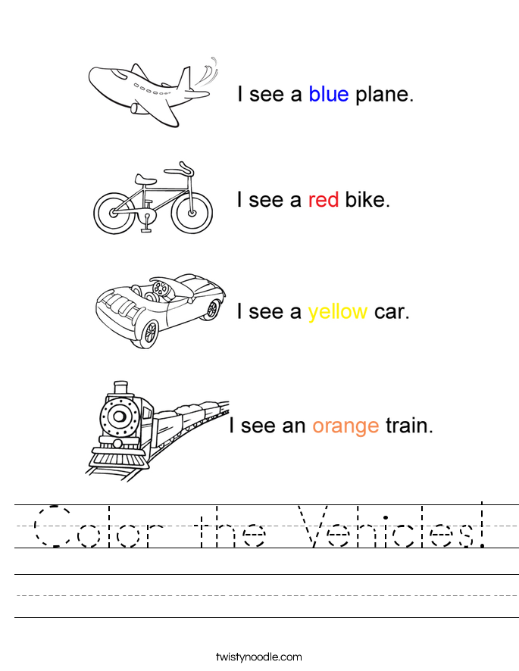

Slide 8
GROUP 2

Slide 9
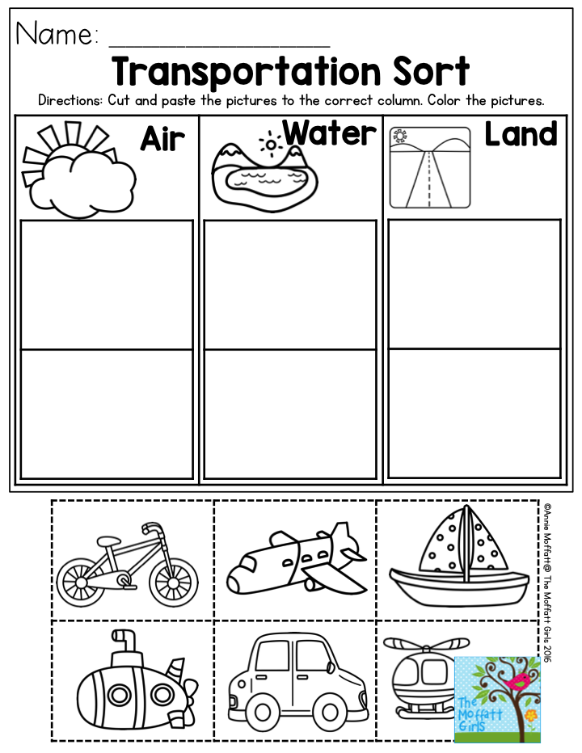

Slide 10
GROUP 3

Slide 11
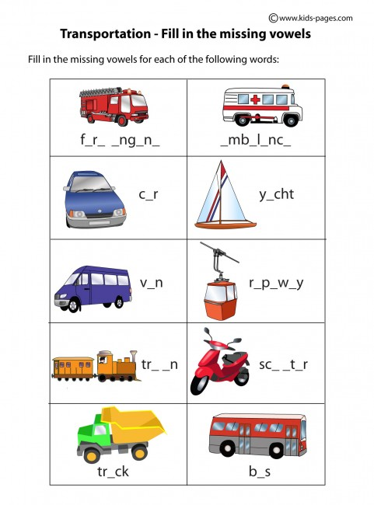

Slide 12
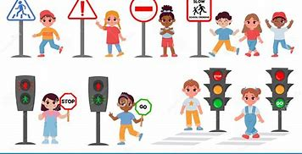
ROAD/ TRAFFIC SAFETY

Slide 13


Slide 14
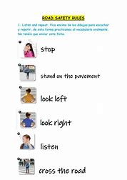

Slide 15
GROUP 1

Slide 16
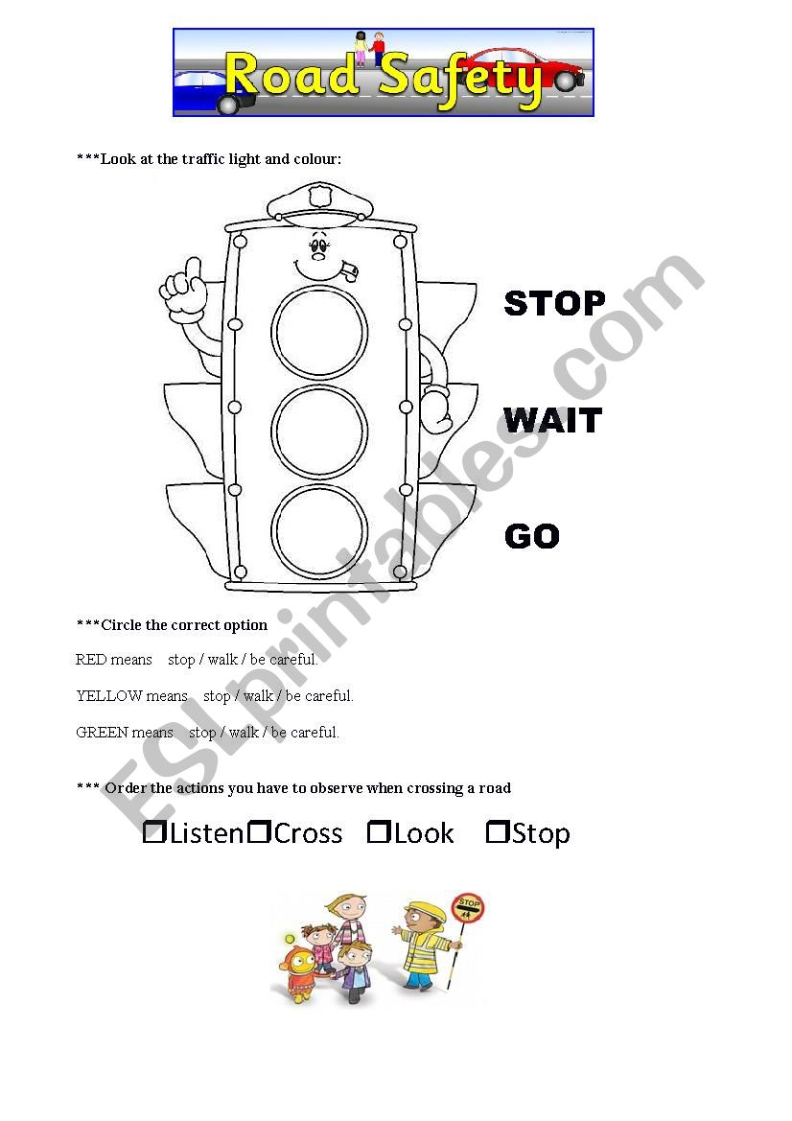

Slide 17
GROUP 2

Slide 18
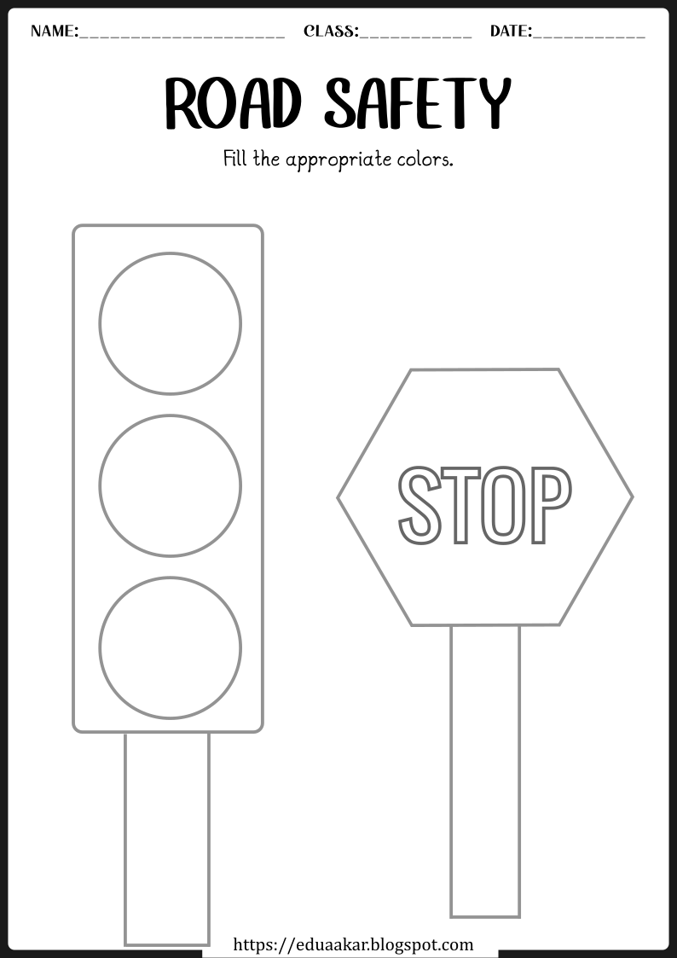

Slide 19
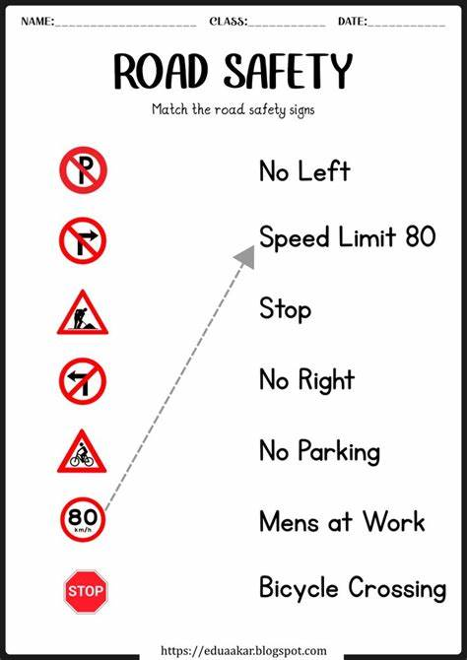

Slide 20
GROUP 3

Slide 21
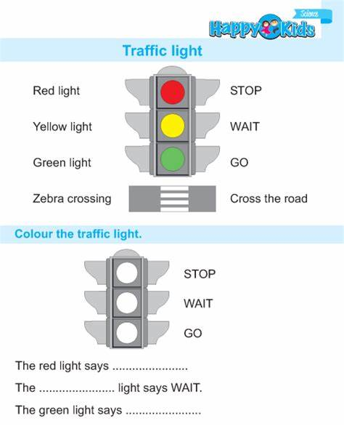

Slide 22
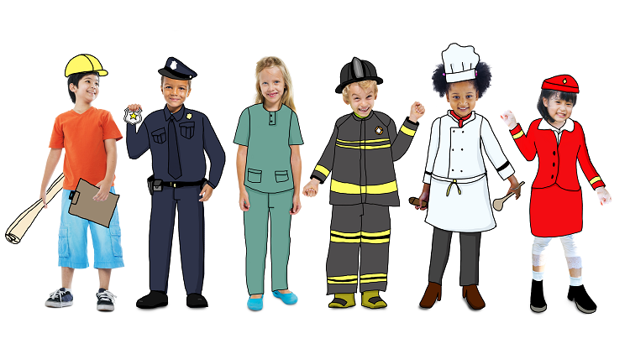
PEOPLE WHO HELP US

Slide 23
GROUP 1

Slide 24
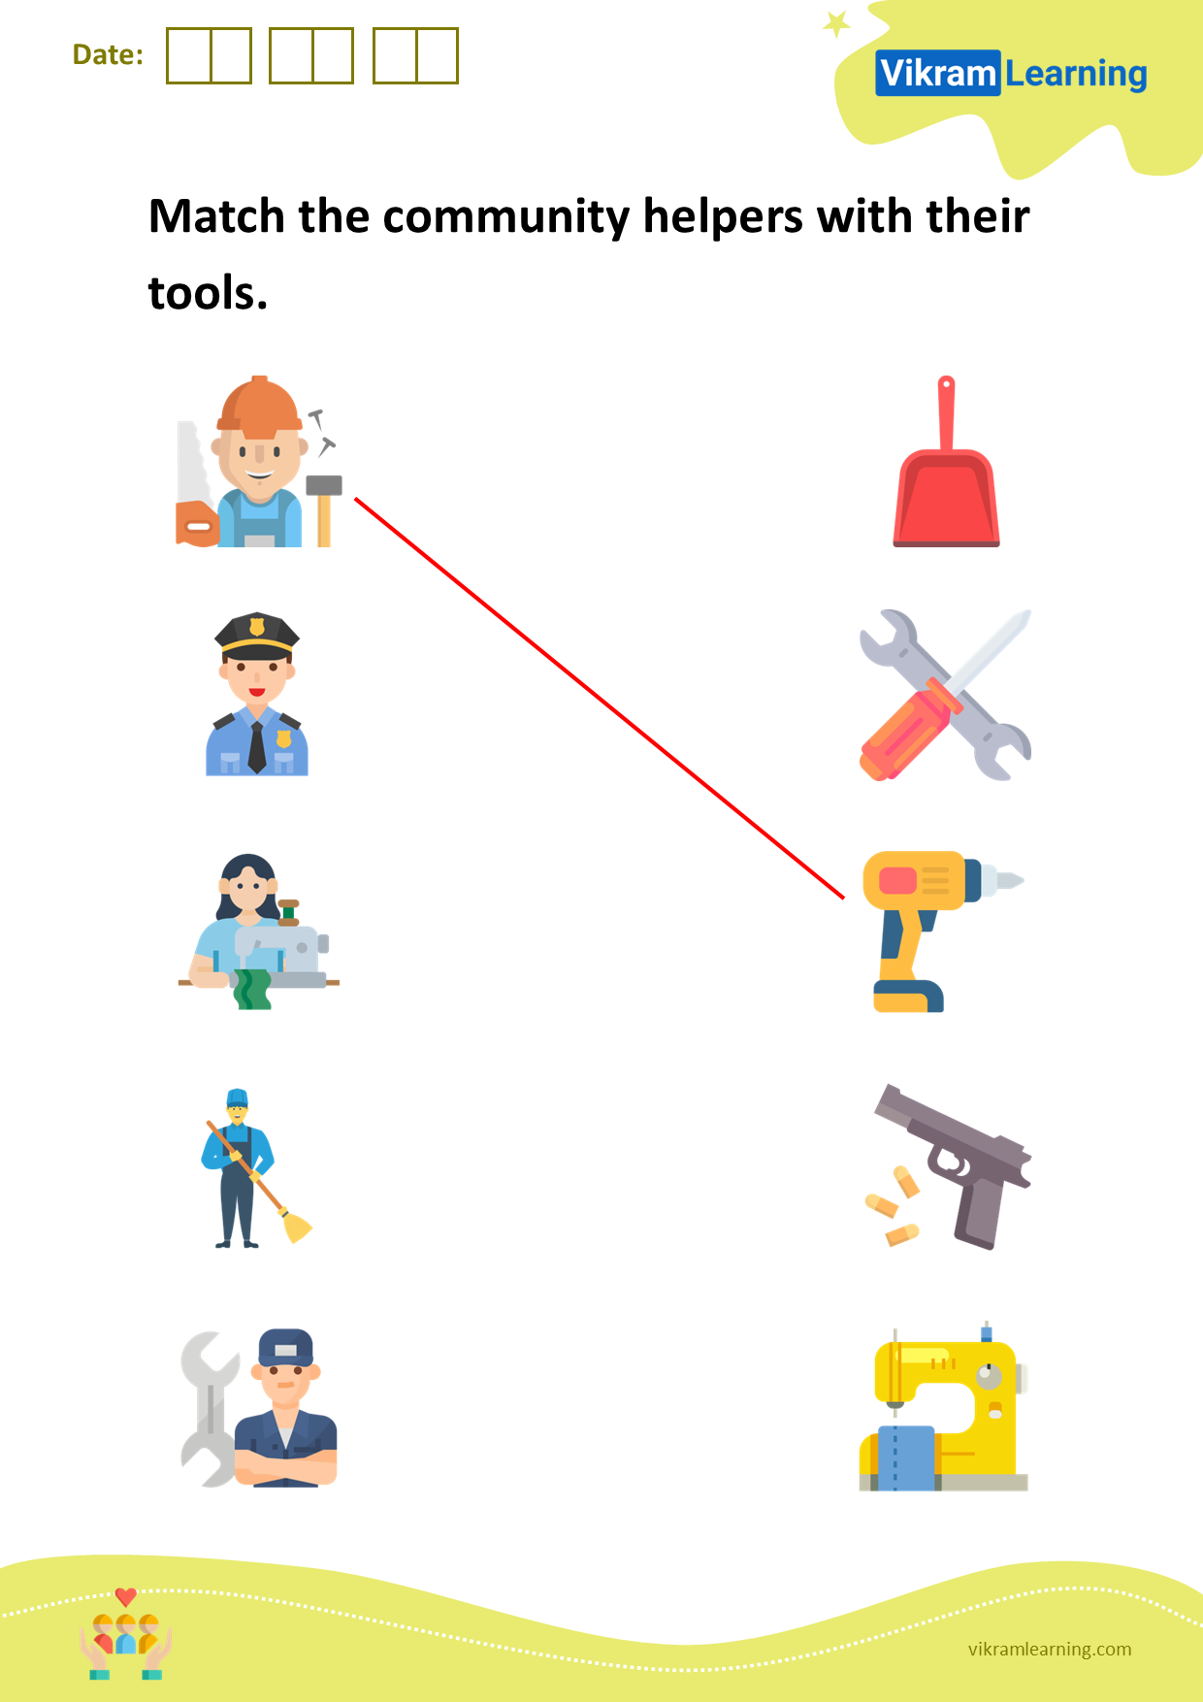

Slide 25
Group 2

Slide 26
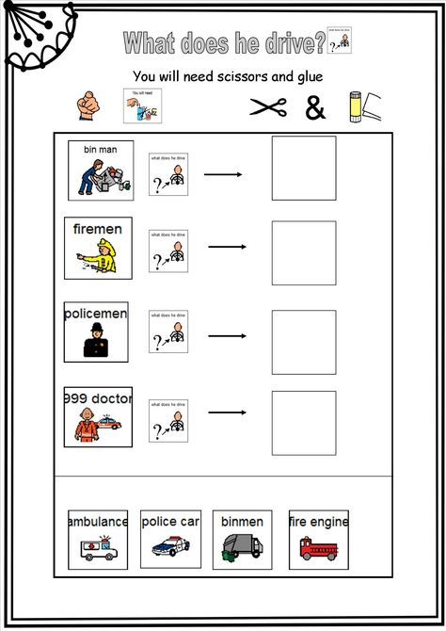

Slide 27
Group 3

Slide 28
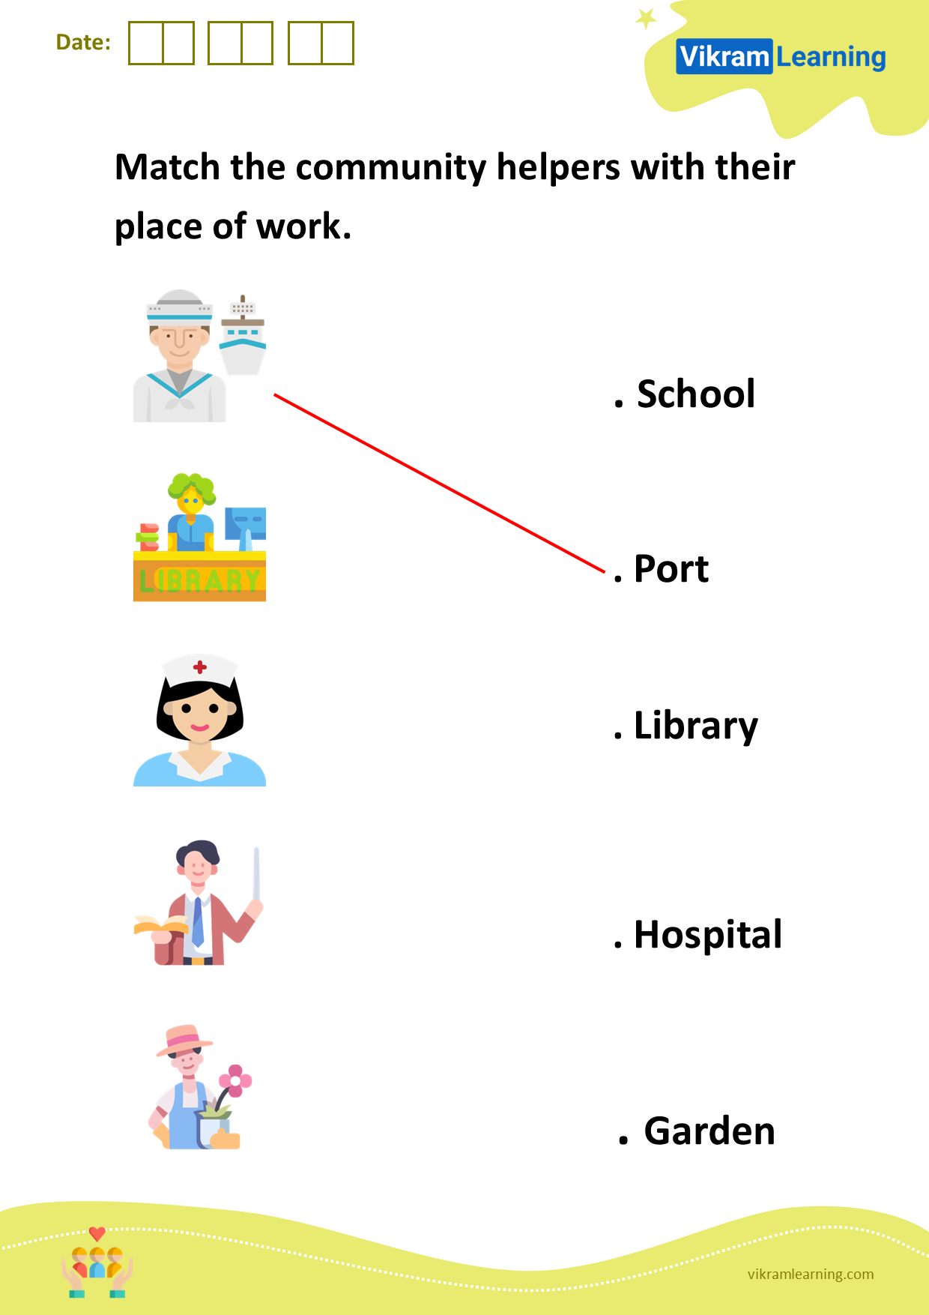

Slide 29
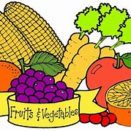
FRUIT AND VEGETABLES

Slide 30
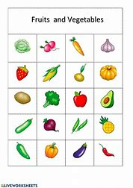

Slide 31
GROUP 1

Slide 32
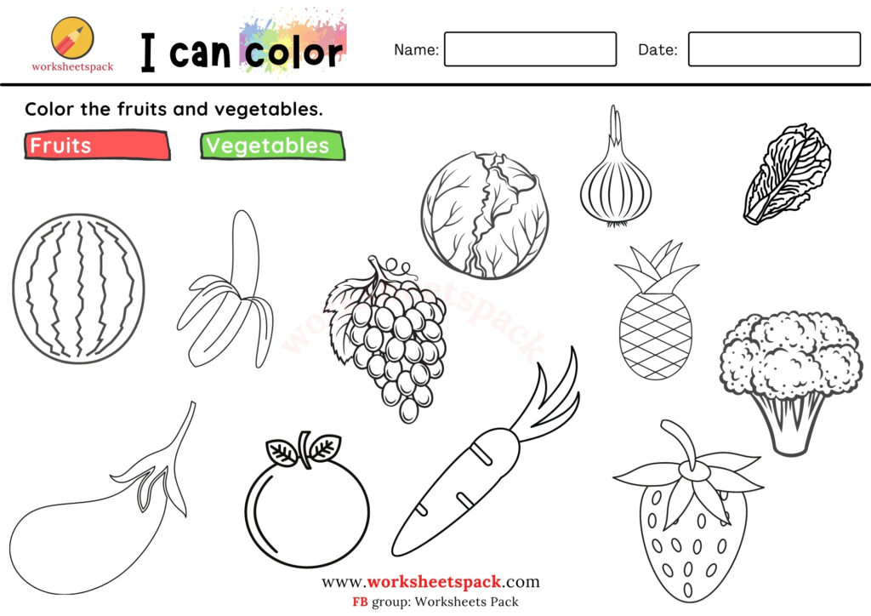

Slide 33
GROUP 2

Slide 34
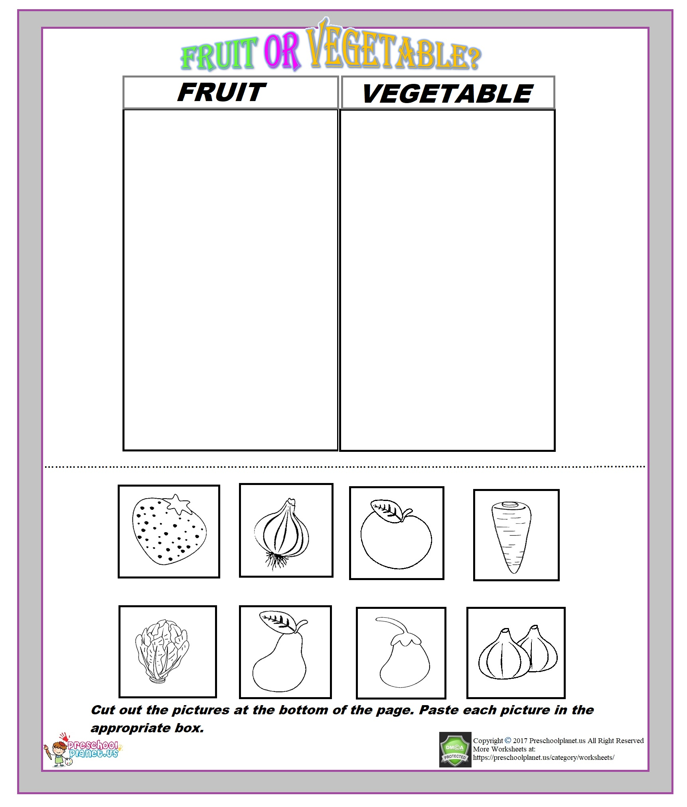

Slide 35
GROUP 3

Slide 36
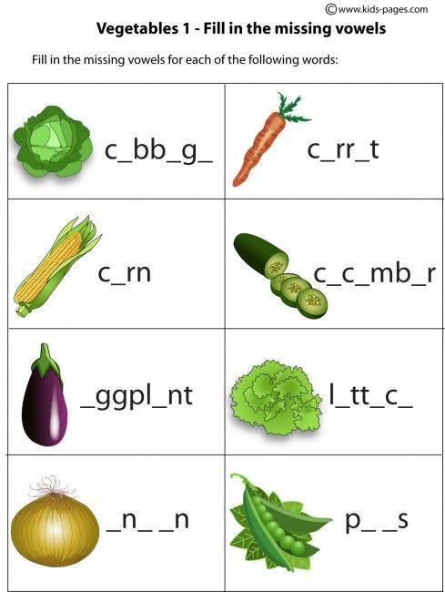

Slide 37
REFERENCES
https://s.twistynoodle.com/img/r/transportation-colors/color-the-vehicles/color-the-vehicles_worksheet.png?ctok=20150910165506
https://i.pinimg.com/originals/40/6f/35/406f3504021321ff88e7c4a3928a5bbc.png
https://blogger.googleusercontent.com/img/b/R29vZ2xl/AVvXsEhfrCnpDxwXyfvXWrV-6fn6M5JekpVayvxHs1fHxCxivQM2JrfqZrq-mrs5-_W8Ov3i6fYyVHrVFq1Cj7WiQ_vBKT-yfhbhetJu4Nn-ul3qWWvzHiHh_r7K2z29czilCFYWDow0FvoF28uopKa_zfU6o-Vo40EEnVs_vvZ7C09E38qrOFifxXbnzDEi/s1123/road-safety-worksheet-1a.png
https://vikramlearning.com/blob/worksheets/3qIetoY/3qIetoY.png
https://vikramlearning.com/blob/worksheets/k30ENBj/k30ENBj.png
https://worksheetspack.com/wp-content/uploads/2021/08/Printable-fruits-and-vegetables-coloring-pages-for-kids-1024x724.jpg
https://preschoolplanet.us/wp-content/uploads/2018/06/fruit-vegetable-worksheet-for-kids.jpg

